Slide 1


Name: Robert Kelemen
Date:12-February-2023

Slide 2

Outline
Executive Summary
Introduction
Methodology
Results
Conclusion
Appendix

Slide 3
Executive Summary
The goal of this capstone project is to predict whether the SpaceX Falcon 9 first stage will land successfully. If it is possible to determine if the first stage will land, then it can determine the cost of a launch. This goal will be achieved using different machine learning classification algorithms.
The methodology include Data Collection, Data Wrangling and Preprocessing, Exploratory Data Analysis, Data Visualization and finally, Machine Learning Prediction.
During investigation, the results of analysis indicate that there are some features of rocket launches that have a correlation with the success or failure launches.
The final conclusion is that the Decision Tree may be the best machine learning algorithm to solve this problem.

Slide 4
Introduction
The commercial space age is here, and companies are making space travel affordable for everyone. One reason SpaceX can do this is the rocket launches are relatively inexpensive. SpaceX claims to be able to reuse the first stage of a rocket launch so that they advertise on their website that their rocket launches cost 62 million while other provides cost upward 165 million.
Much of these savings are down to the first stage's reusability. If we can determine if the first stage will land, we can determine the cost of a launch. This information can be used if an alternate company wants to bid against SpaceX for a rocket launch. Therefore, if we can determine if the first stage will land, we can determine the cost.
This brings us to our main question: For a given set of features about a Falcon 9 rocket launch, will the first stage of the rocket land successfully?

Slide 5

Section 1

Slide 6
Methodology
Executive Summary
Data collection methodology:
Data was collected through two methods: requesting data from the SpaceX API and web scraping launch data from a Wikipedia page.
Perform data wrangling
Data wrangling was then performed to transform and clean the data using Python's pandas library.
Perform exploratory data analysis (EDA) using visualization and SQL
With the clean data, exploratory data analysis (EDA) was performed using visualization tools such as Python's matplotlib and seaborn libraries, as well as answering questions using SQL queries.

Slide 7
Methodology
Executive Summary
Perform interactive visual analytics using Folium and Plotly Dash
Python's interactive visualization packages were used to answer some analytical questions. Folium was used for creating maps while Plotly Dash was used to create interactive data visualizations.
Perform predictive analysis using classification models
Four different machine learning classification models were used for the predictive analysis. The models that were used are logistic regression, support vector machines, k-nearest neighbour and decision tree classifier. Each model was trained, tuned and evaluated to find the best one.

Slide 8
Data Collection
Describe how data sets were collected.
You need to present your data collection process use key phrases and flowcharts

Slide 9
Data Collection – SpaceX API
requests.get(spacex_url)
.json_normalize()
Pd.DataFrame(launch_dict)
df['BoosterVersion']!= 'Falcon 1'
.replace(np.nan, pm_mean, inplace=True)
Request and parse the SpaceX launch data using the GET request
Normalize JSON response into a dataframe
Extract only useful columns using auxilary functions
Create new pandas dataframe from dictionary
Filter the dataframe to only include Falcon 9 launches
Dealing with Missing Values
Export to CSV
GitHub URL: Data Collection API

Slide 10
Data Collection - Scraping
requests.get(static_url)
extract_column_from_header(row)
pd.DataFrame(launch_dict)
df.to_csv('spacex_web_scraped.csv', index=False)
Request rocket launch data from its Wikipedia page
Extract all column/variable names from the HTML table header
Create a data frame by parsing the launch HTML tables
Export to CSV file
GitHub URL: Data Collection With Web Scrping

Slide 11
Data Wrangling
df['LaunchSite'].value_counts()
df['Orbit'].value_counts()
landing_outcomes=df['Outcome'].value_counts()
df['Class']=landing_class
Calculate the number of launches on each site
Calculate the number and occurrence of each orbit
Calculate the number and occurrence of mission outcome per orbit type
Create a landing outcome label from Outcome column using one-hot encoding
Export to CSV
You need to present your data wrangling process using key phrases and flowcharts
GitHub URL: Exploratory Data Analysis

Slide 12
EDA with Data Visualization
Scatter plots: Scatter plots were used to represent the relationship between two variables. Different sets of features were compared such as Flight Number vs. Launch Site, Payload vs. Launch Site, Flight Number vs. Orbit Type and Payload vs. Orbit Type.
Bar chart: Bar charts were used makes it easy to compare values between multiple groups at a glance. The x-axis represents a category and the y-axis represents a discrete value. Bar charts were used to compare the Success Rate for different Orbit Types
Line chart: Line charts are useful for showing data trends over time. A line chart was used to show Success Rate over a certain number of Years.
GitHub URL: EDA with Data Visualisation

Slide 13
EDA with SQL (1/2)
SQL Queries were to solve following tasks:
Display the names of the unique launch sites in the space mission
Display 5 records where launch sites begin with the string 'CCA’
Display the total payload mass carried by boosters launched by NASA (CRS)
Display average payload mass carried by booster version F9 v1.1
List the date when the first succesful landing outcome in ground pad was acheived.
List the names of the boosters which have success in drone ship and have payload mass greater than 4000 but less than 6000
GitHub URL: EDA with SQL

Slide 14
EDA with SQL (2/2)
List the total number of successful and failure mission outcomes
List the names of the booster_versions which have carried the maximum payload mass.
List the records which will display the month names, failure landing_outcomes in drone ship ,booster versions, launch_site for the months in year 2015.
Rank the count of successful landing_outcomes between the date 04-06-2010 and 20-03-2017 in descending order.
GitHub URL: EDA with SQL

Slide 15
Build an Interactive Map with Folium
Objects were created and added to a Folium map. Marker objects were used to show all launch sites on a map and the successful/failed launches for each site on the map. Line objects were used to calculate the distances between a launch site to its proximities
Following geographical patterns about launch sites are found using these objects:
Are launch sites in close proximity to railways? Yes
Are launch sites in close proximity to highways? Yes
Are launch sites in close proximity to coastline? Yes
Do launch sites keep certain distance away from cities? Yes
GitHub URL: Interactive Map with Folium

Slide 16
Build a Dashboard with Plotly Dash
The dashboard application contains two charts:
A pie chart that shows the successful launch by each site. This chart is useful as you can visualize the distribution of landing outcomes across all launch sites or show the success rate of launches on individual sites.
A scatter chart that shows the relationship between landing outcomes an the payload mass of different boosters. The dashboard takes two inputs, namely the site(s) and payload mass. This chart is useful as you can visualize how different variables affect the landing outcomes,
GitHub URL :

Slide 17
Predictive Analysis (Classification)
ata['Class'].to_numpy()
transform=preprocessing.StandardScaler()
X=transform.fit_transform(X)
X_train,X_test,Y_train,
Y_test=train_test_split(X,Y,test_size=0.2,random_state=2)
lr=LogisticRegression()
logreg_cv=GridSearchCV(lr,parameters,cv=10)
logreg_cv.fit(X_train,Y_train)
plt.barh(method,accuracy)
plt.xlabel('Accuracy')
plt.ylabel('Method')
plt.show()
Create column for “Class”
Standardizing the data
Split into training and test set
Find best Hyperparameter for SVM, Decision Trees, K-Nearest Neighbours and Logistic Regression
Use test data to evaluate models based on their accuracy scores and confusion matrix
GitHub URL: SpaceX Machine Learning Prediction

Slide 18
Results
The results of the exploratory data analysis reveale that the success rate of the Falcon 9 landings was 66.66%
The predictive analysis results showed that the Decision Tree algorithm was the best classification method with an accuracy of 89%

Slide 19

Section 2

Slide 20
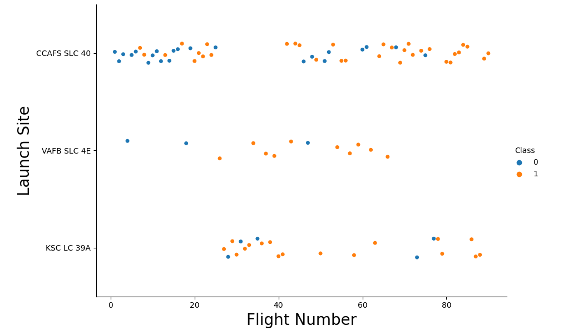
Flight Number vs. Launch Site
This figure shows that the success rate increased as the number of flights increased.
The blue dots represent the successful launches while the red dot represent unsuccessful luanches.
There seems to be an increase in successful flights after the 40th launch.

Slide 21
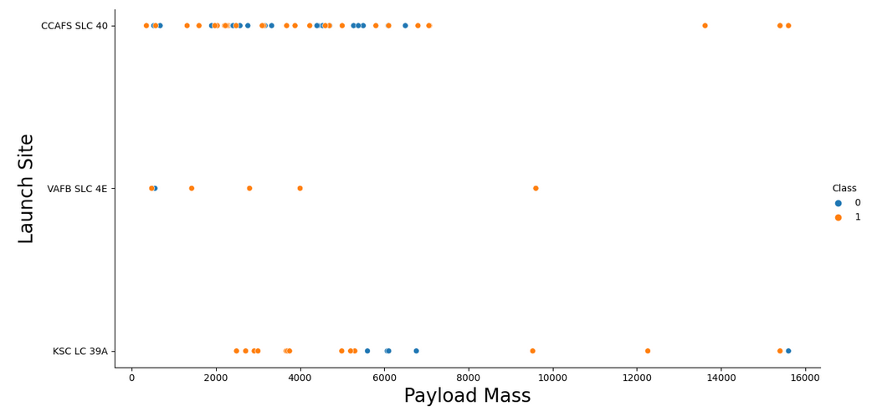
Payload vs. Launch Site
The blue dots represent the successful launches while the red dots represent unsuccessful launches.
For the VAFB-SLC launchsite there are no rockets launched for heavy payload mass
There seems to be a weak correlation between Payload and Launch Site and therefore decisions cannot be made using this metric.

Slide 22
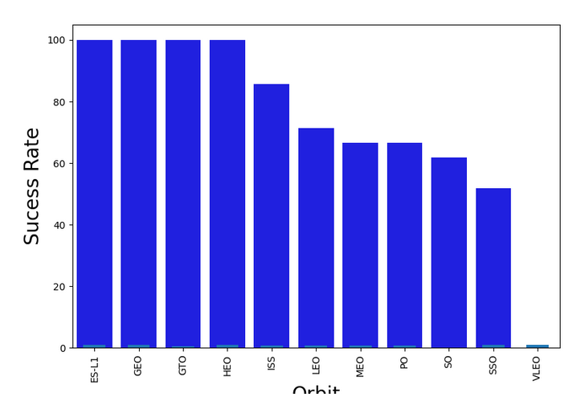
Success Rate vs. Orbit Type
Orbits ES-L1, GEO, GTO, and HEO have 100% success rates.
VLEO has the lowest success rate

Slide 23
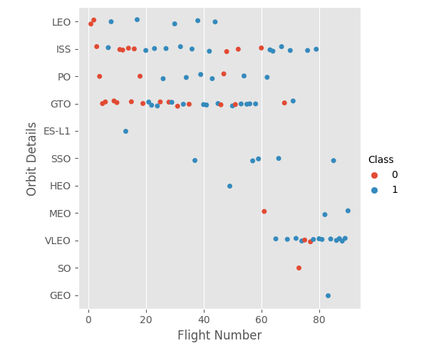
Flight Number vs. Orbit Type
In the LEO orbit, the success is positively correlated to the the number of flights.
There seems to be no relationship between flight number in the GTO orbit.
The SSO orbit has a 100% success rate however with fewer flights than the other orbits
Flight numbers greater than 40 have a higher success rate than flight numbers between 0-40.

Slide 24
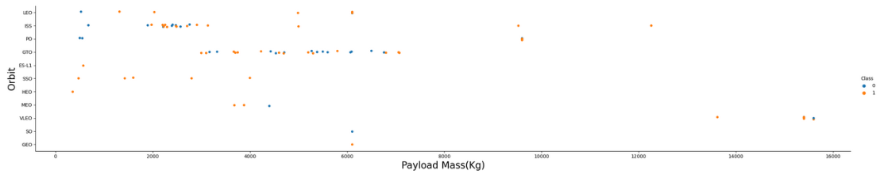
Payload vs. Orbit Type
As the payloads get heavier, the success rate increases in the PO, SSO, LEO and ISS orbits.
There seems to be no direct correlation between obrit type and payload mass for GTO orbit as both successful and failed launches are eually present

Slide 25
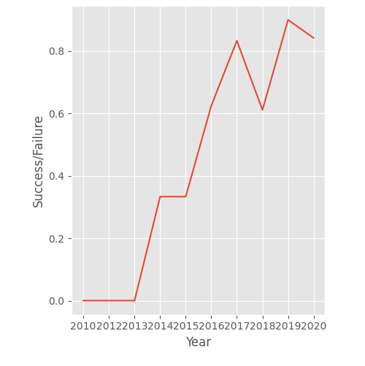
Launch Success Yearly Trend
The general trend of the chart shows an increase in landing success rate as the years pass. There is however a dip in 2018 as well as in 2020.

Slide 26
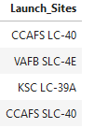
All Launch Site Names
The DISTINCT clause was used to return only the unique rows from the launch_site column.
The names of the launch sites are CCAFS LC-40, CCAFS SLC-40, KSC LC-39A, VAFB SLC-4E .

Slide 27
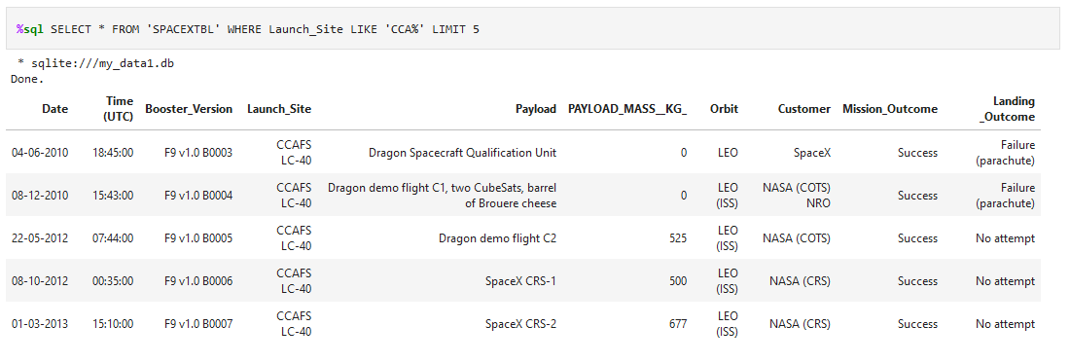
Launch Site Names Begin with 'CCA'
The LIMIT and LIKE clauses were used to display only the top five results where the launch_site name starts with 'CCA'

Slide 28
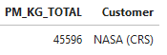
Total Payload Mass
The SUM() function was used to the calculate the total payload carried by boosters from NASA from the payload_mass__kg column.

Slide 29
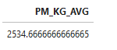
Average Payload Mass by F9 v1.1
The AVG() function was used to the calculate the average payload the average payload mass carried by booster version F9 v1.1
The WHERE clause was used to filter results so that the calculations were only performed on booster_versions only if they were named “F9 v1.1”

Slide 30

First Successful Ground Landing Date
The MIN(DATE) function was used to find the date of the first successful landing outcome on ground pad
The WHERE clause ensured that the results were filtered to match only when the 'landing_outcome' column is 'Success (ground pad)'

Slide 31
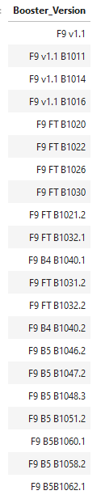
Successful Drone Ship Landing with Payload
between 4000 and 6000
The BETWEEN clause was used to retrieve only those results of payload mass greater than 4000 but less than 6000. The WHERE clause filtered the results to include only boosters which successfully landed on drone ship

Slide 32
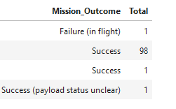
Total Number of Successful and Failure Mission Outcomes
The COUNT() function is used to count the number of occurences of different mission outcomes with the help of the GROUPBY clause applied to the 'mission_outcome' column. A list of the total number of successful and failure mission outcomes os returned.
There have been 98 successful mission outcomes out of 102 missions.

Slide 33
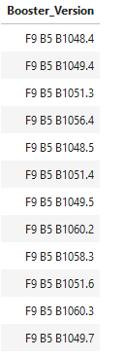
Boosters Carried Maximum Payload
The MAX() function was used in a subquery to retrieve a list of boosters which have carried the maximum payload mass

Slide 34
2015 Launch Records
The SELECT statement was used to retrieve multiple columns from the table. The YEAR(DATE) function was used to retrieve only those rows with a 2015 launch date.

Slide 35
Rank Landing Outcomes Between 2010-06-04 and 2017-03-20
COUNT() function was used to count the different landing outcomes.'The WHERE and BETWEEN clauses filtered the results to only include results between 2010-06-04 and 2017-03-20. The GROUPBY clause ensure that the counts were grouped by their outcome. The ORDERBY and DESC clauses were used to sort the results by descending order.

Slide 36

Section 3

Slide 37
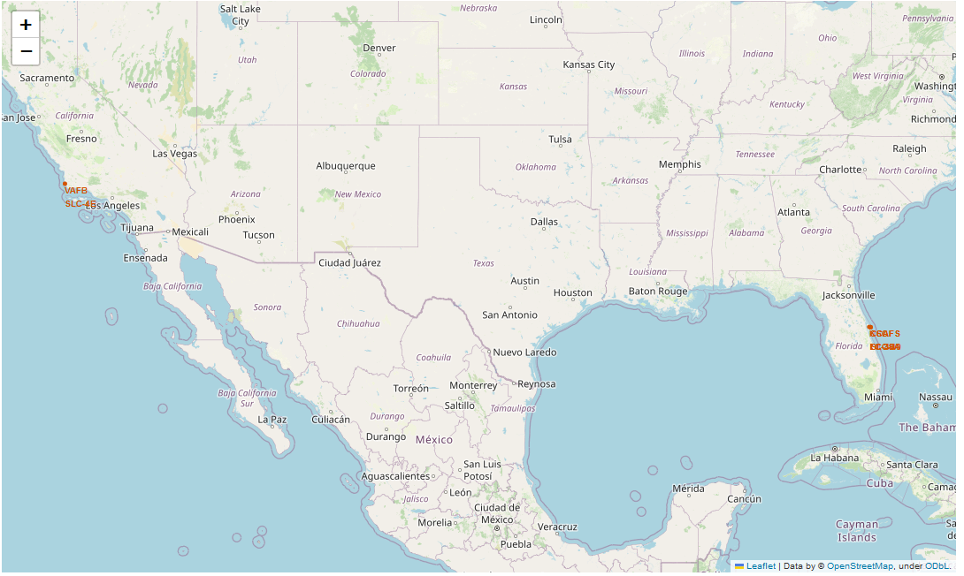
SpaceX Launch Sites Locations
The yellow markers are indicators of where the locations of all the SpaceX launch sites are situated in the US.
The launch sites have been strategically placed near the coast

Slide 38
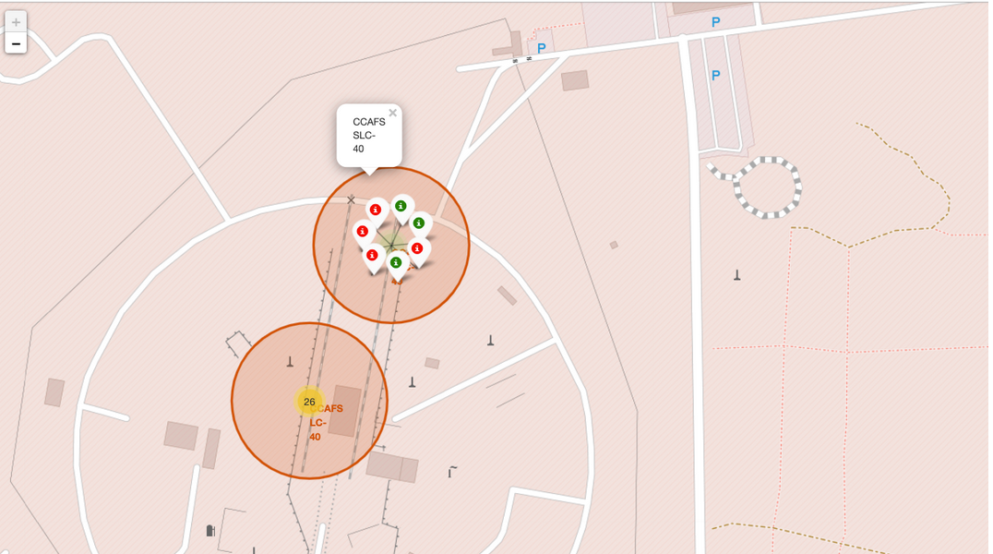
Success or Failure?
When we zoom in on a launch site, we can click on the launch site which will display marker clusters of successful landings (green) or failed landing (red).

Slide 39
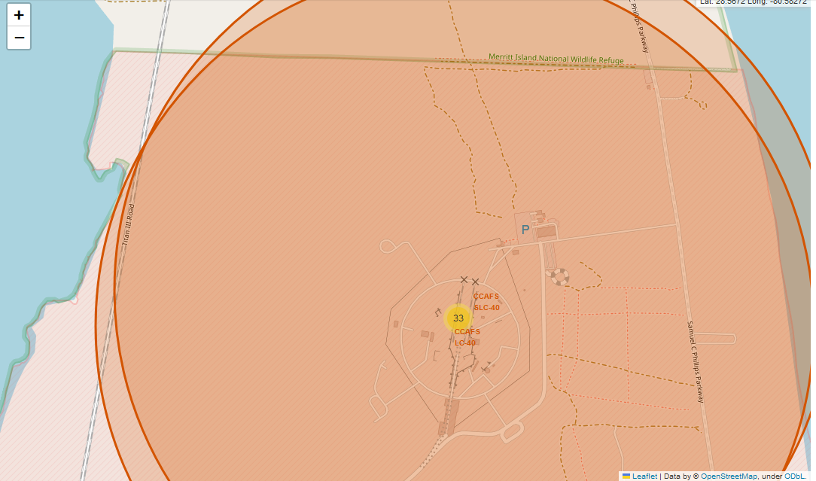
Launch Site Proximities
The generated map shows that the selected launch site is close to a highway for transportation of personnel and equipment. The launch site is also close to the coastlines for launch failure testing.
The launch sites also maintain a certain distance from the cities.

Slide 40

Section 4

Slide 41
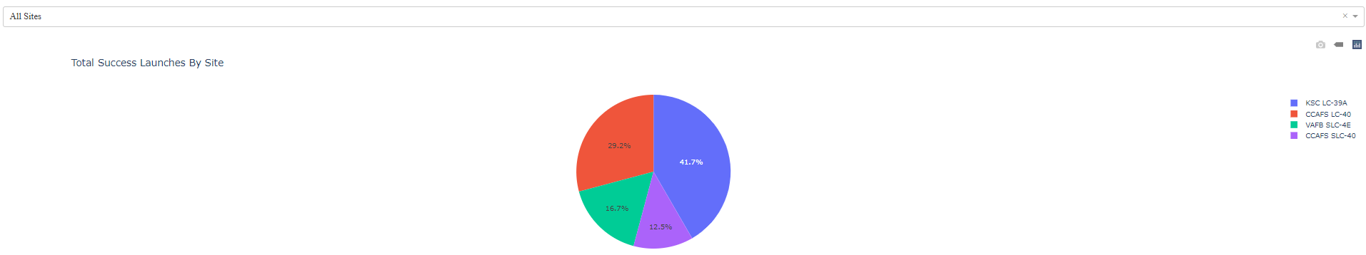
Total Successful Launches By Site
The KSC LC-39A Launch site has the most successful launches with 10 in total.

Slide 42
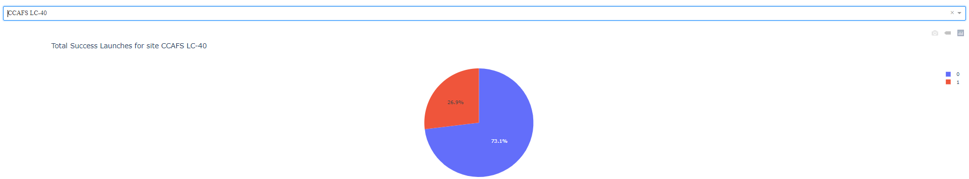
Launch Site With Highest Success Ratio
The KSLC-39A has the highest success rate with 76.9%.

Slide 43
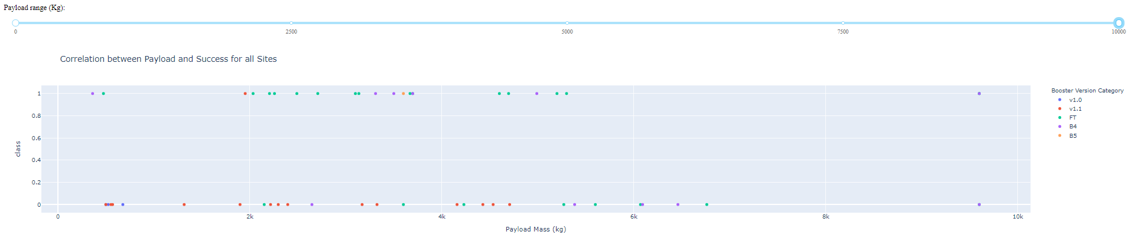
Payloads vs Launch Outcome
The launch success rate for payloads 0-2500 kg is slightly lower than that of payloads 2500-5000 kg. There is in fact not much difference between the two.
The booster version that has the largest success rate, in both weight ranges is the v1.1.

Slide 44

Section 5

Slide 45
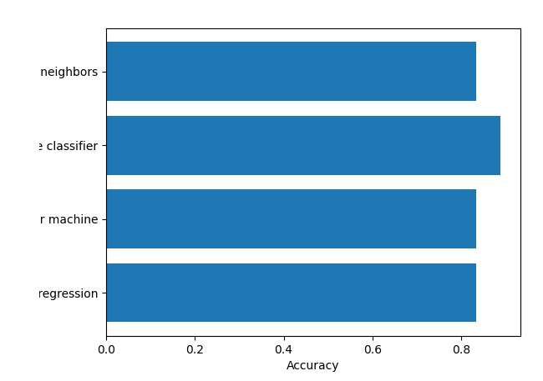
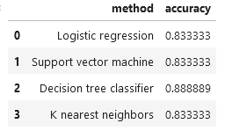
Classification Accuracy
The Decision Tree classifier has the best accuracy at 89%.

Slide 46
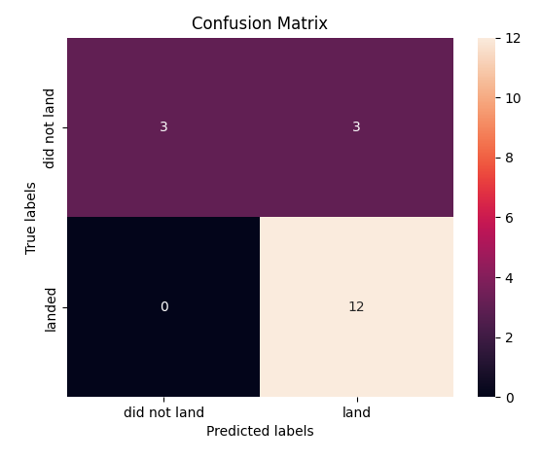
Confusion Matrix
The model predicted 12 successful landings when the True label was successful (True Positive) and 3 unsuccessful landings when the True label was failure (True Negative).
The model also predicted 3 successful landings when the True label was unsuccessful landing (False Positive).
The model generally predicted successful landings.

Slide 47
Conclusions
The analysis showed that there is a positive correlation between number of flights and success rate as the success rate has improved over the years.
There are certain orbits like SSO, HEO, GEO, and ES-L1 where launches were the most successful.
Success rate can be linked to payload mass as the lighter payloads generally proved to be more successful than the heavier payloads.
The launch sites are strategically located near highways and railways for transportation of personel and cargo, but also far away from cities for safety.
The best predictive model to use for this dataset is the Decision Tree Classifier as it had the highest accuracy with 89%.

Slide 48
Appendix
Coursera Project Link: https://www.coursera.org/learn/applied-data-science-capstone/home/welcome
GitHub Repository: https://github.com/nemelek6/Coursera_Capstone

Slide 49


